Slide 1

YouTube Content Strategy Analysis
Subtitle: "Making Informed Decisions for Video Uploads"
Problem Statement:
When deciding between uploading mathematics or physics tutorial videos on YouTube, educators and professionals need to know which subject will attract more viewers and engagement.

Slide 2
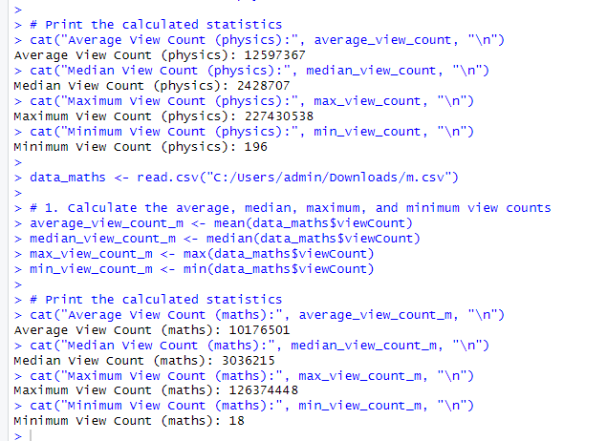

1.VIEW COUNT ANALYSIS
Average and Median View Counts and Maximum and Minimum View Counts:

Slide 3
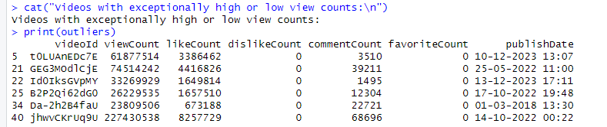
OUTLIERS
1.The number of outliers identified for mathematics and physics videos.
MATHS:7 PHYSICS:6
2.The absence of lower fence values, indicating no significant disadvantages in posting videos for either subject.
3.Differences in higher fence values, suggesting variations in viewer engagement over time.
Specifically, highlight the observation that the higher fence for mathematics videos corresponds to increased views in January and February, while for physics videos, it aligns with increased views in December and October.

Slide 4
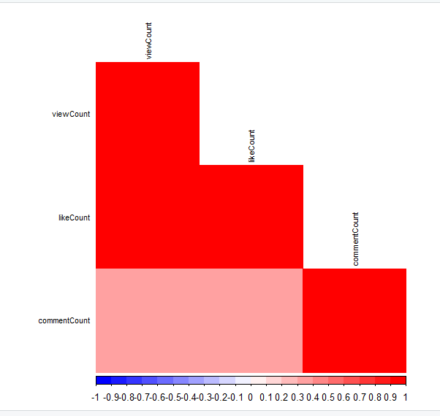
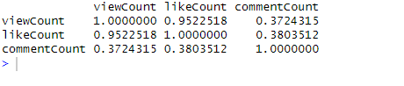
2.Engagement analysis
Positive correlation between the number of likes and the view count for both mathematics and physics videos
0.9522518

Slide 5
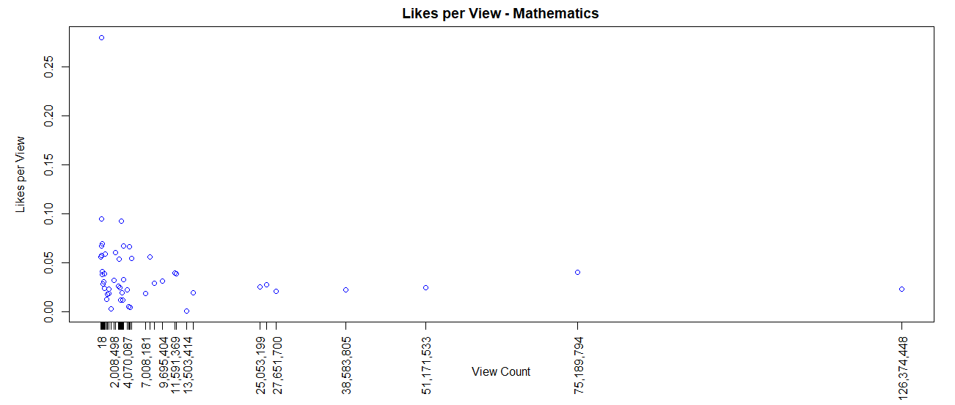
Likes per view

Slide 6
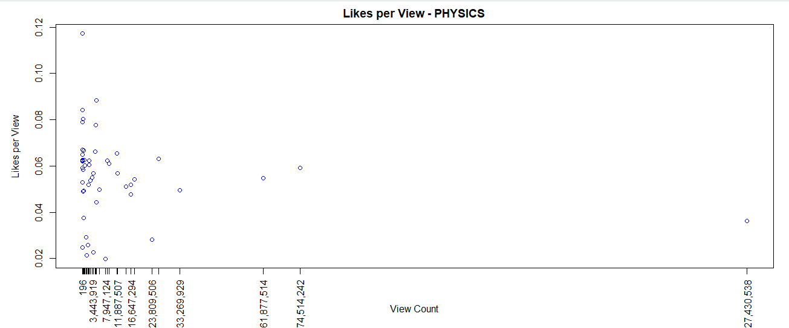
The "likes per view" metric is higher for physics videos compared to mathematics videos. This implies that viewers tend to engage more positively with physics content relative to mathematics content on YouTube.

Slide 7
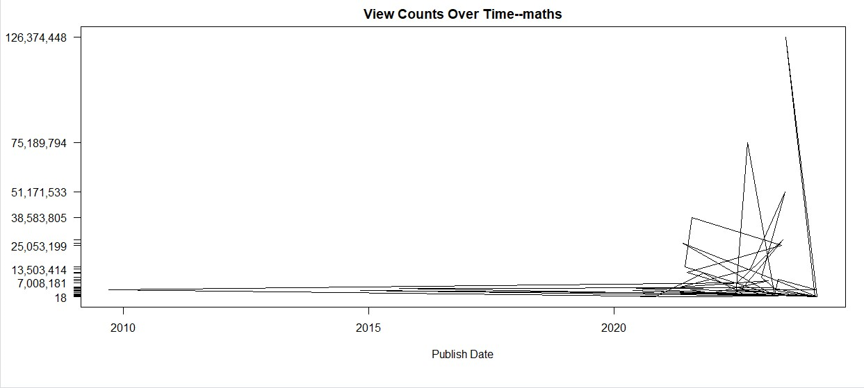
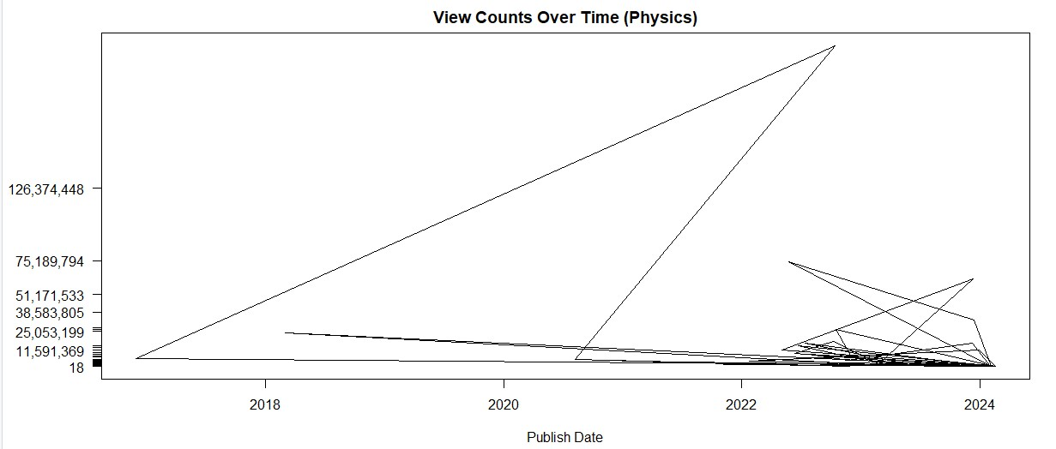
3.TIME SERIES ANALYSIS
1.VIEW COUNT OVER YEAR

Slide 8
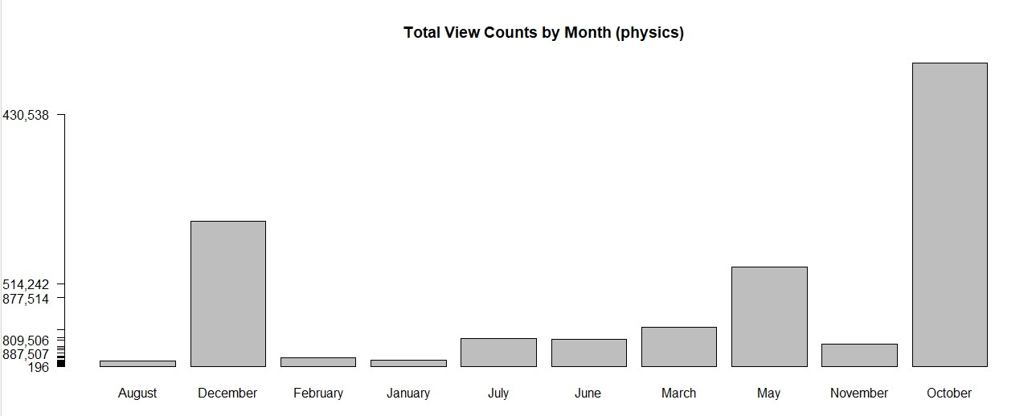
view count

Slide 9
T
H
A
N
K
S

